Slide 1


Slide 13
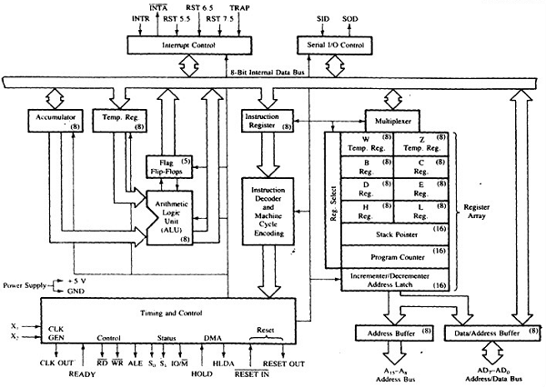
INTERNAL ARCHITECTURE OF 8085 Microprocessor

Slide 18
Flag Register
8 bit register – shows the status of the microprocessor before/after an operation
S (sign flag), Z (zero flag), AC (auxillary carry flag), P (parity flag) & CY (carry flag)
Sign Flag
Used for indicating the sign of the data in the accumulator
The sign flag is set if negative (1 – negative)
The sign flag is reset if positive (0 – positive)

Slide 19
Zero Flag
Is set if result obtained after an operation is 0
Is set following an increment or decrement operation of that register
Carry Flag
Is set if there is a carry or borrow from arithmetic operation
10110011
+ 01001101
---------------
1 00000000
1011 0101
+ 0110 1100
---------------
Carry 1 0010 0001
1011 0101
- 1100 1100
---------------
Borrow 1 1110 1001

Slide 20
Auxillary Carry Flag
Is set if there is a carry out of bit 3
Parity Flag
Is set if parity is even
Is cleared if parity is odd
1011 0101
+ 0110 1100
---------------
1 0010 0001

Slide 28
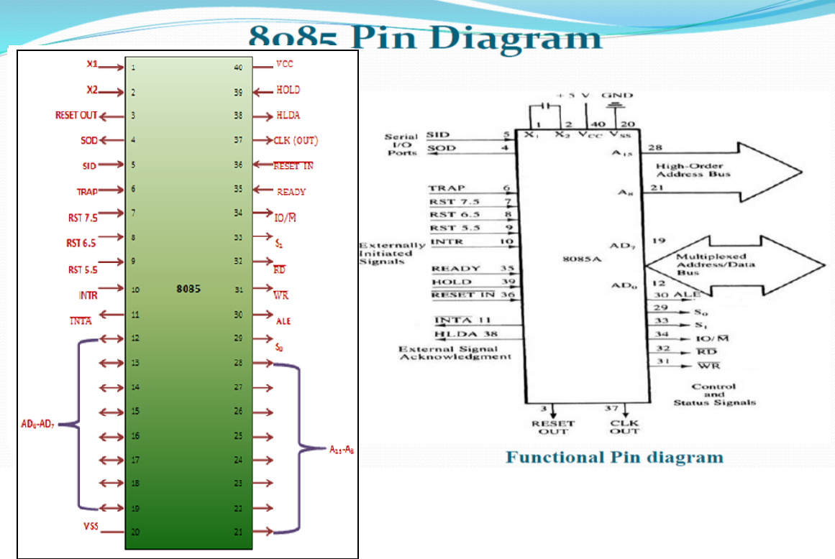

Slide 35
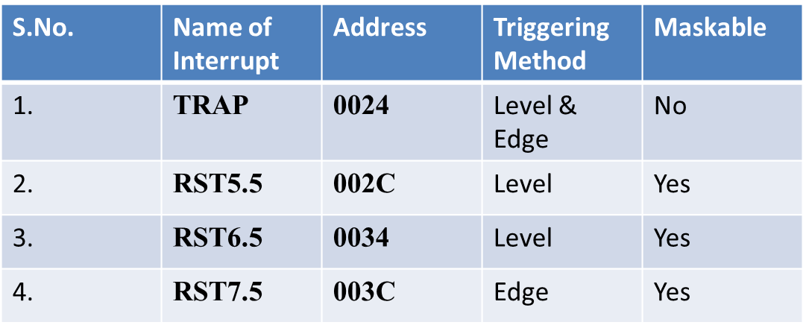
INTR (input): It is an interrupt request signal. Among interrupts it has lowest priority. When it goes high the program counter does not increment its contents. The microprocessor suspends its normal sequence of operations. After completing the instruction at hand it goes to the call instruction. The INTR line is sampled in the last state of the last machine cycle of the instruction. The microprocessor acknowledges the interrupt signal and issues INTA signal.
RST-5.5, RST-6.5, RST-7.5 and TRAP (inputs): These are interrupts. When an interrupt is recognized the next instruction is executed from a fixed location in the memory as given below:
RST 7.5, 6.5, 5.5 are the restart interrupts. They cause an internal restart to be automatically inserted. Each of them has a programmable mask. The TRAP has the highest priority among interrupts. It is a non-maskable interrupts. It is unaffected by any mask or interrupt. The priority of the interrupts is in the order of TRAP(Highest) , RST7.5. RST6.5, RST5.5, INTR.

Slide 42
Demultiplexing Address/Data Bus
8085 identifies a memory location with its 16 address lines, (AD0 to AD7) & (A8 to A15)
8085 performs data transfer using its data lines, AD0 to AD7
Lower order address bus & Data bus are multiplexed on same lines i.e. AD0 to AD7.
Demultiplexing refers to separating Address & Data signals for read/write operations

Slide 43
Need for Demultiplexing…
RD
8085
A8-A15
Memory
20H
AD0-AD7
05H
4FH

Slide 44
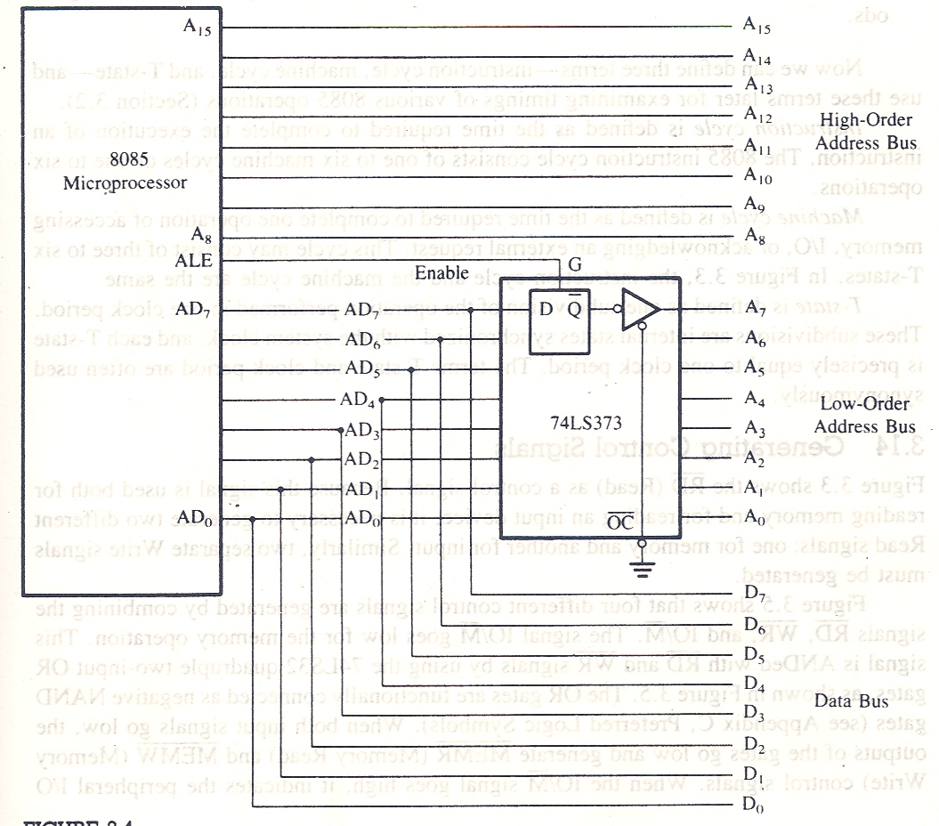

Slide 45
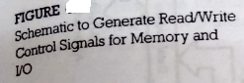

Slide 48
There are different ways of specifying data for instructions, the machine codes of all the instructions are not of the same length.
There are three different types of the INTEL 8085 instructions as described below :
Single Byte instruction- MOV A,B
2) Two Byte instruction. MVI B,05
3) Three Byte instruction. LDA 2500H

Slide 49
Each instruction require certain data on which it has to operate. It has various techniques to specify data for instructions. These techniques are known as ADDRESSING MODES.
In 8085 there are 4 types of addressing modes:
Direct Addressing
Register Addressing
Register Indirect Addressing
Immediate Addressing.
Implicit Addressing.

Slide 50
Direct addressing:
For example:
STA 2400H:
IN 02:
Register Addressing:
For example:
MOV A,B:
ADD B:

Slide 51
Register indirect addressing:
For example:
LXI H, 2500H: MOV A,M : HLT:
LXI H, 2500H:
ADD M :
HLT:

Slide 52
Immediate Addressing:
For example:
MVI A,05 :
ADI 06 :
Implicit Addressing:
For example
CMA :
RAR :
RAL :

Slide 53
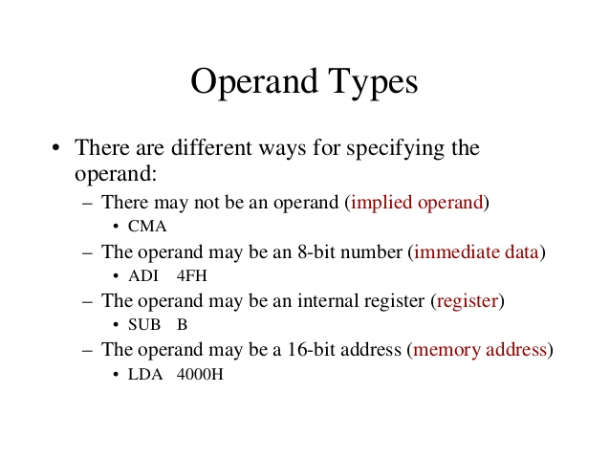

Slide 54
Machine Cycle and Bus Timings
Instruction Cycle
Machine Cycle
T state
IC = FC + EC

Slide 55
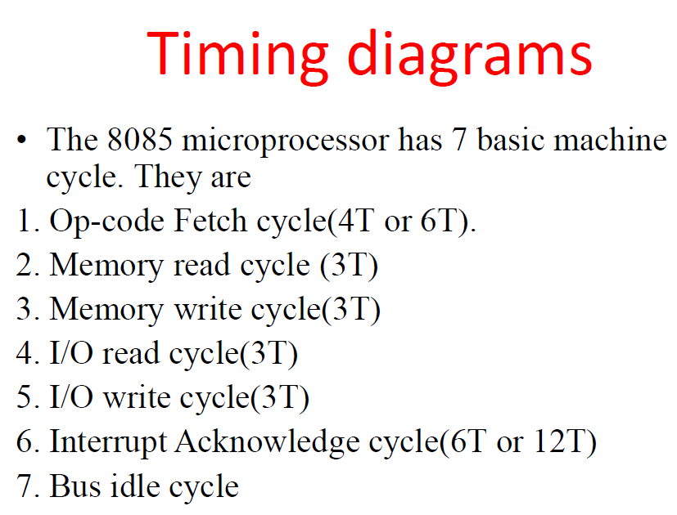

Slide 56
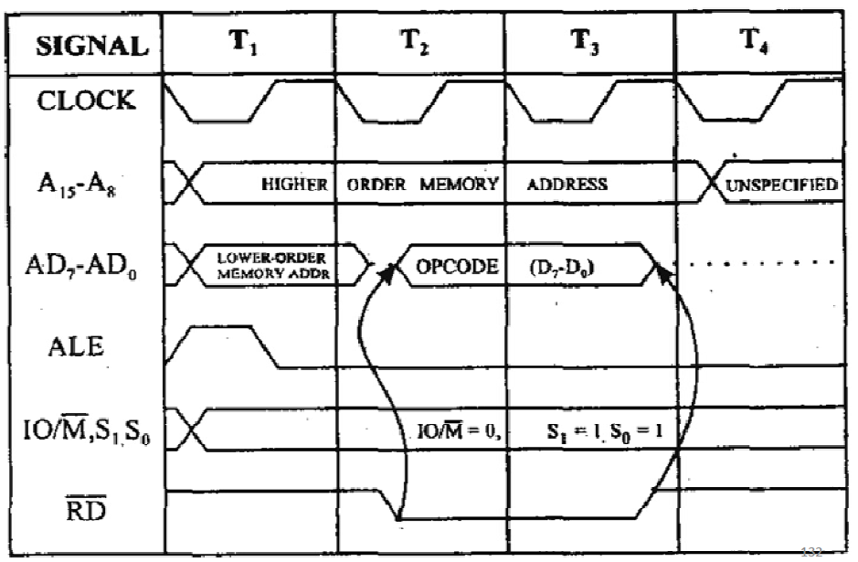
Opcode Fetch Cycle (4T or 6T)

Slide 57
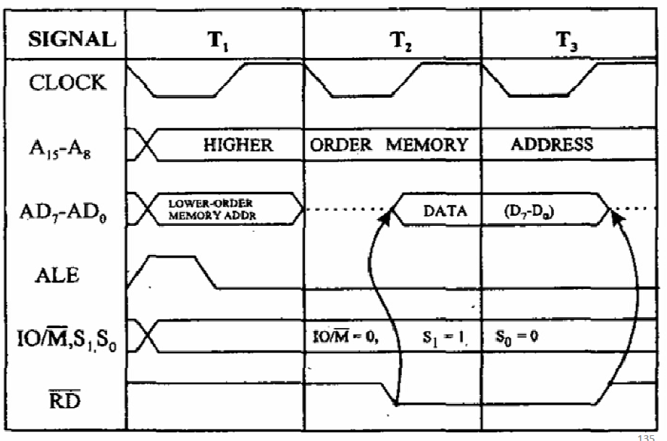
Memory Read Cycle (3T states)

Slide 58
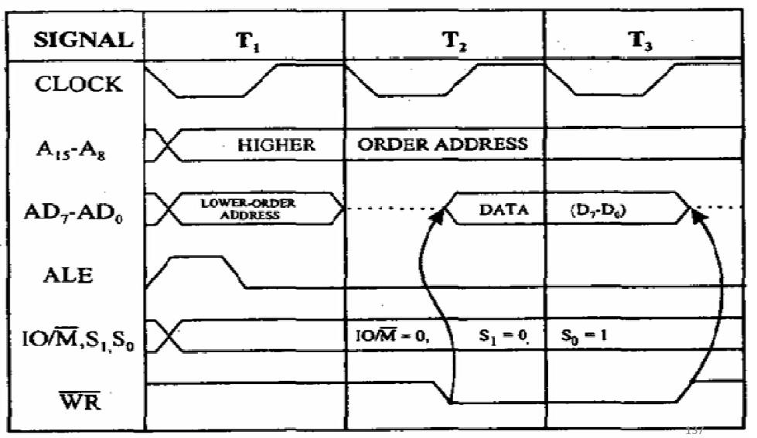
Memory Write Cycle (3T states)

Slide 61
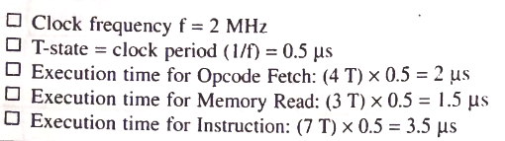

Slide 62
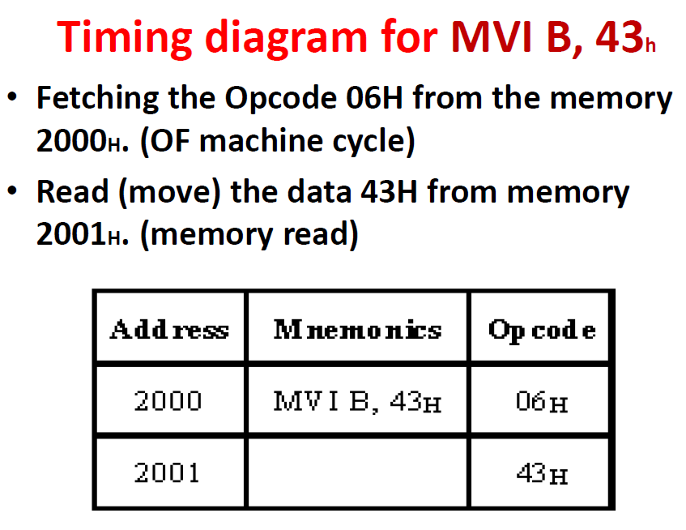

Slide 63
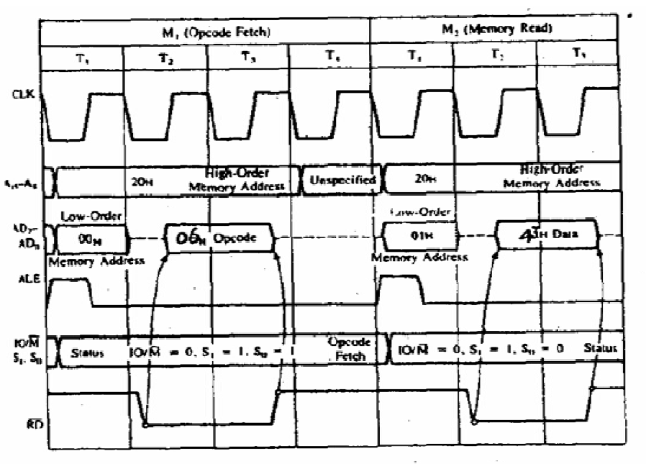

Slide 64
TIMING DIAGRAM OF MOV B,A
Address | Mnemonics | Opcode
4080H | Mov B,A | 47H
A C C U M U L A T O R
FF H
REG. B FFH

Slide 65
